Slide 1
CSS

Slide 2
Introduction
CSS, or Cascading Style Sheets, is a language used to style and enhance websites.
It controls how HTML elements—such as text, images, and buttons—are displayed on a webpage.
With CSS, you can adjust font sizes and colors, add backgrounds, and manage the layout, transforming a basic webpage into a visually appealing and user-friendly experience.
CSS also simplifies layout management across multiple web pages by using external stylesheets stored in CSS files.

Slide 3
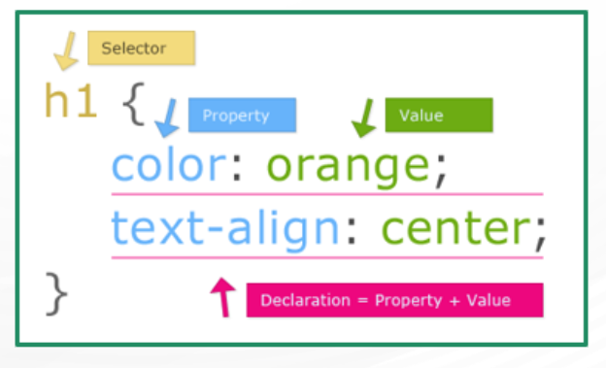

Slide 4
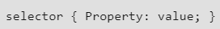
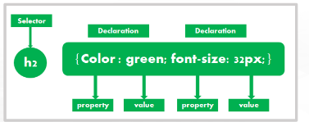
CSS Syntax
A CSS rule-set consists of two parts : a selector and a declaration block:
Selector- The HTML element that is to be styled.
declaration block -has declarations on how to style. There can be one or more declarations, separated by semicolons (;).
CSS Comments: Use /* comment */ to add comments within CSS, which are ignored by the browser.

Slide 5
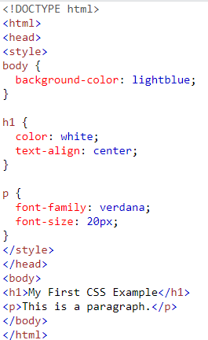
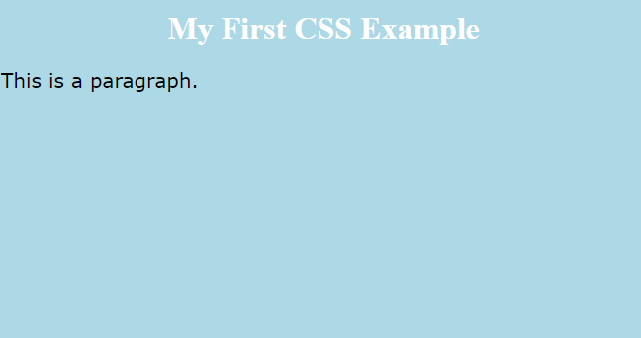
Example

Slide 6
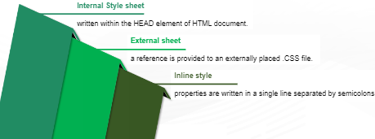
How To Insert CSS in HTML
There are three ways of inserting a style sheet:
External CSS
Internal CSS
Inline CSS

Slide 7
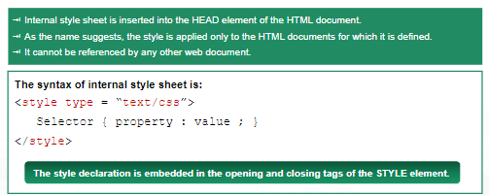
Internal CSS

Slide 8
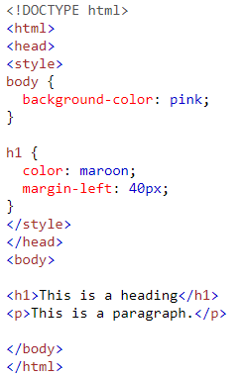
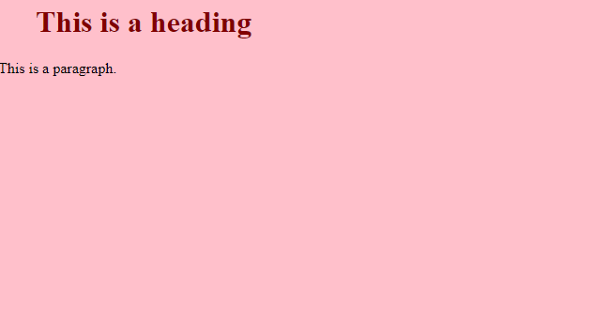
Example

Slide 9
External CSS
With an external style sheet, you can change the look of an entire website by changing just one file!
Each HTML page must include a reference to the external style sheet file inside the <link> element, inside the head section.
An external style sheet can be written in any text editor, and must be saved with a .css extension.
The external .css file should not contain any HTML tags.

Slide 10
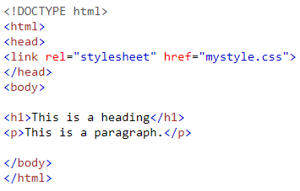
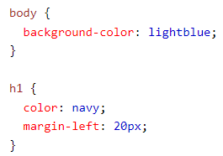

Note: Do not add a space between the property value (20) and the unit (px).

Slide 11
The external style sheet can be linked to a web page in the following ways:
Linking
Importing
Linking : To link a sheet we can use the HTML LINK element. The attributes for LINK element are - rel, type and href.
Example: <LINK rel=”style sheet” type=”text/css” href=”mysheet.css”/>
Importing: You can also access the style rules from other CSS Style sheets.
The @import keyword is used, followed by the Uniform Resource Identifier (URI) of the style
sheet to which you want to import the style sheet rules.
Example:
<STYLE TYPE=”text/css”>
@import url(mystylesheet.css”)
H1 { color : blue }
</STYLE>

Slide 12
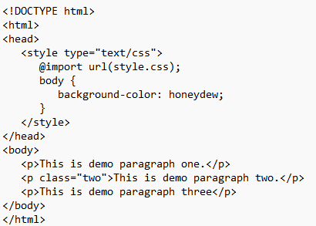
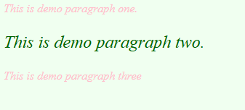
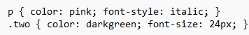
style.css

Slide 13
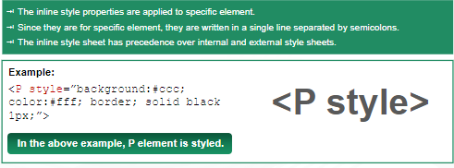
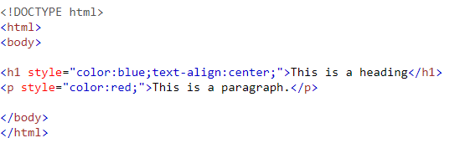
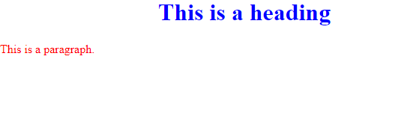
Inline CSS

Slide 14
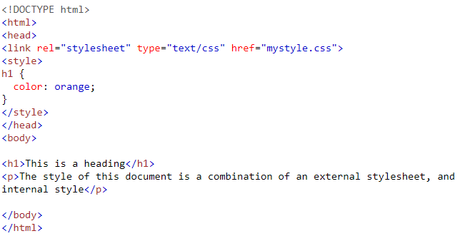
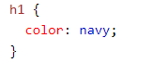
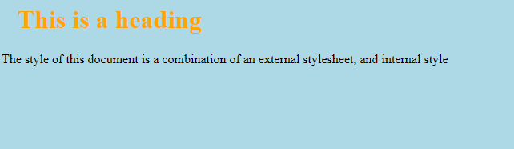
Multiple Style Sheets
If some properties have been defined for the same selector (element) in different style sheets, the value from the last read style sheet will be used.
External :

Slide 15
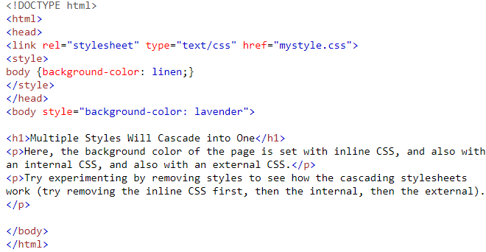
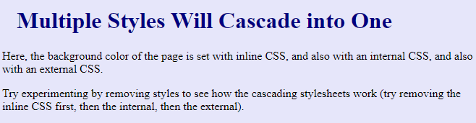
Cascading Order
What style will be used when there is more than one style specified for an HTML element?
All the styles in a page will "cascade" into a new "virtual" style sheet by the following rules, where number one has the highest priority:
Inline style (inside an HTML element)
External and internal style sheets (in the head section)
Browser default
So, an inline style has the highest priority, and will override external and internal styles and browser defaults.

Slide 16
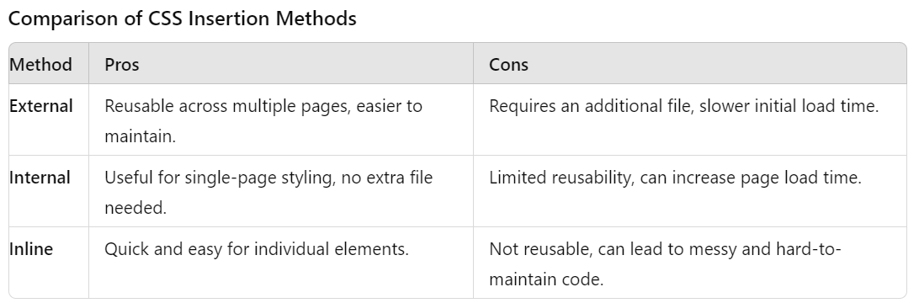

Slide 17
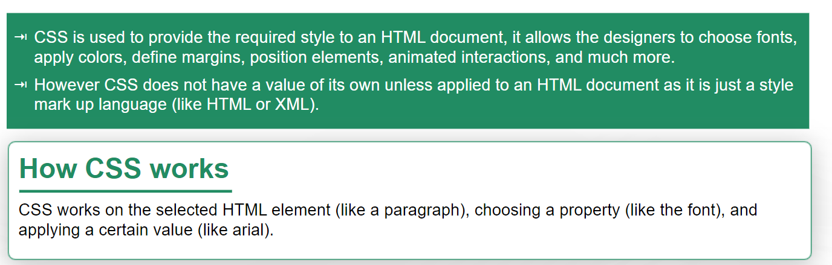
How CSS adds value to HTML

Slide 18
Basic CSS properties
font-family : sans-serif, arial, etc
font-size : in px, percentage or em
font-weight : normal, bold
font-style: normal, italic
text-transform : uppercase, capitalize, lowercase
text-decoration : none, underline, overline, line-through
text-align : left, right, center, justify
color, background-color
width and height

Slide 19
CSS3
CSS3 stands for Cascading Style Sheets Level 3. It is an advanced version of CSS, used for structuring, styling, and formatting web pages. One of the most significant advancements in CSS3 is the splitting of CSS standards into separate modules, making it simpler to learn and use.
New Features of CSS3
Combinator: CSS3 introduces a new general sibling combinator, which matches sibling elements using the tilde (~) combinator
CSS Selectors: CSS3 selectors are more advanced than the simple selectors offered by CSS, providing a sequence of easy-to-use and simple selectors.
Pseudo-elements: CSS3 adds many new pseudo-elements for easier and more detailed styling. The new convention of double colons (::) is also introduced.
Border Style: CSS3 includes new border styling features like border-radius, border-image-slice, border-image-source, and values for “width stretch”.
Background Style Properties: CSS3 introduces new background style properties such as background-clip, background-size, background-style, and background-origin.
.

Slide 20
CSS Selectors
CSS selectors are used to "find" (or select) the HTML elements you want to style.
We can divide CSS selectors into five categories:
Simple selectors (select elements based on name, id, class)
Combinator selectors (select elements based on a specific relationship between them)
Pseudo-class selectors (select elements based on a certain state)
Pseudo-elements selectors (select and style a part of an element)
Attribute selectors (select elements based on an attribute or attribute value)

Slide 21
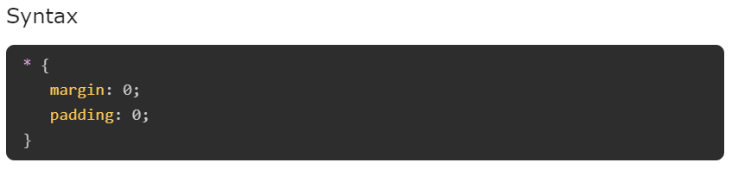
Universal Selectors
Universal selector, denoted by an asterisk mark (*), is a special selector that matches all elements in an HTML document.
These are generally used to add a same length margin and padding to all the elements in document.

Slide 22
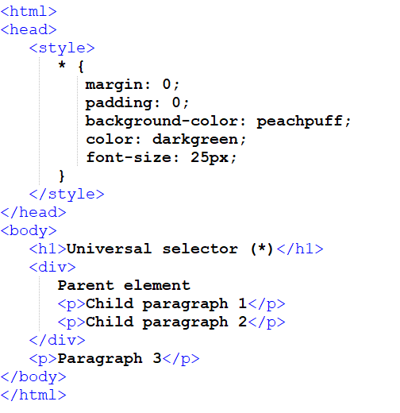
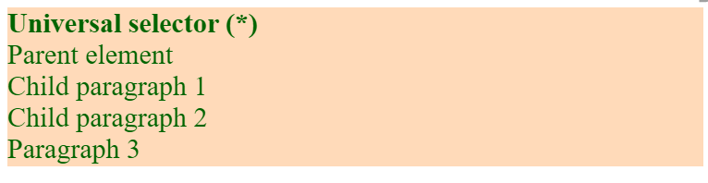

Slide 23
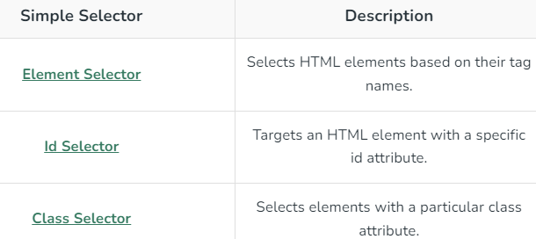
Simple Selectors
It is used to select the HTML elements based on their element name, id, attributes, etc

Slide 24
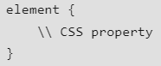
CSS element Selector
The element selector in CSS is used to select HTML elements that are required to be styled.
An element selector targets all elements of a specific type on a web page, such as all paragraphs (<p>) or all headings (<h1>).
In a selector declaration, there is the name of the HTML element and the CSS properties which are to be applied to that element is written inside the brackets {}.
Syntax:

Slide 25
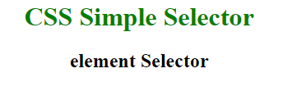
<!DOCTYPE html>
<html>
<head>
<title>element selector</title>
<style>
/* h1 element selected here */
h1 { color: green; text-align: center; }
/* h2 element selected here */
h2 { text-align: center; }
</style>
</head>
<body>
<h1>CSS Simple Selector</h1>
<h2>element Selector</h2>
</body>
</html>

Slide 26
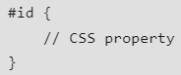
CSS #id Selector
The “#” CSS id selector is used to set the style of an element with a given id.
The id attribute is a unique identifier in an HTML document, ensuring that the id selector applies styles to a single, unique element.
The id selector is prefixed with the “#” character.
Syntax:

Slide 27
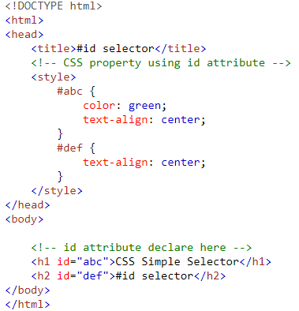
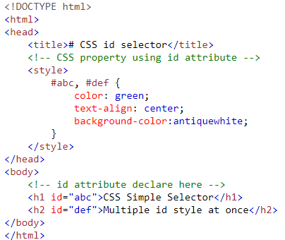
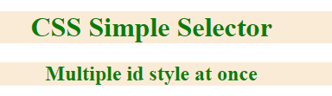
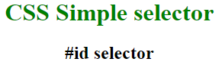
Styling multiple elements with different ids using the same style.

Slide 28
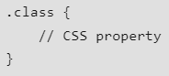
CSS Class Selector
The CSS .class selector is used to select all elements that belong to a specific class attribute.
By using the period (.) character followed by the class name, you can apply CSS properties to all elements with that class.
Syntax:

Slide 29
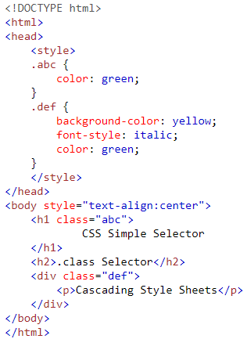
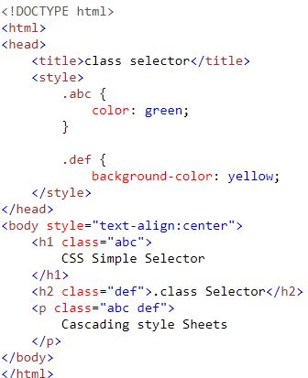
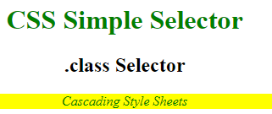
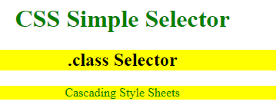

Slide 30
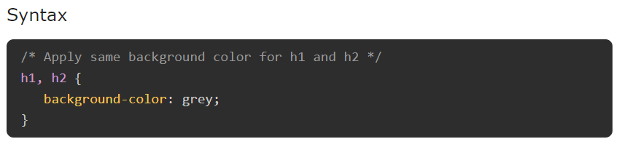
CSS Group Selector
CSS group selector allow us to apply same style to multiple elements at a time.
Name of elements can be separated by commas.
This method is recommended as it keep CSS concise and avoid redundancy.

Slide 31
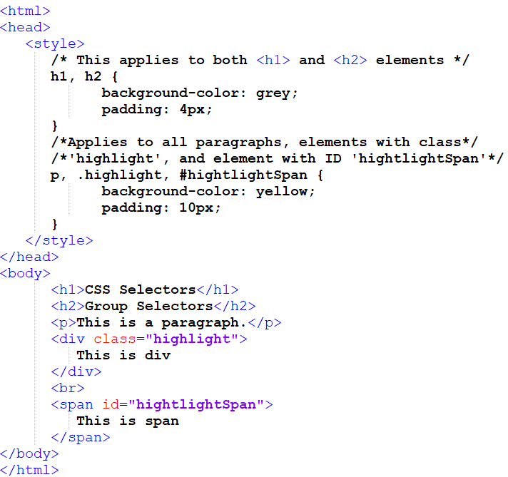
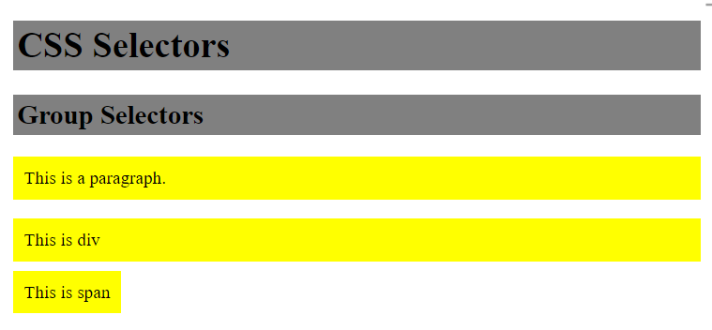

Slide 32
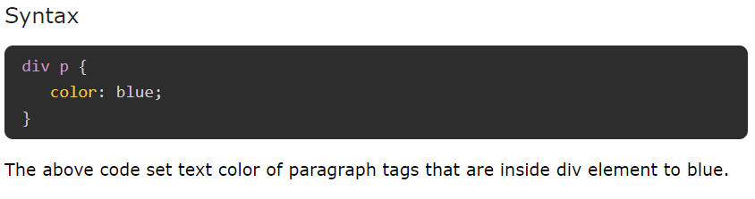
Combinator Selectors:: Descendant Selector
Selects elements that are descendants of a specified element. (not just a direct child of that element)
Descendant selector is used in css to style all the tags which are child of a particular specified tag.
A single space between parent element and child element is used to mention as descendant.

Slide 33
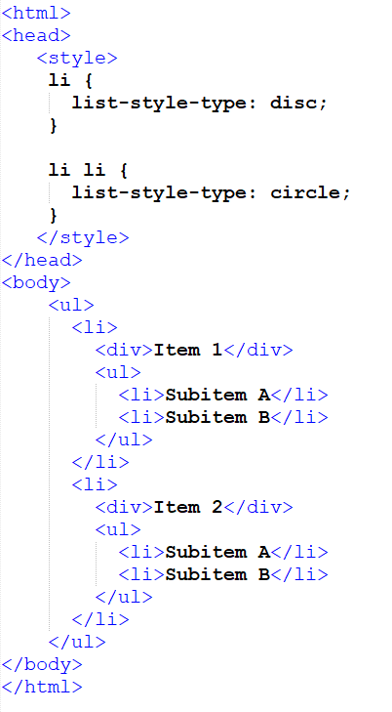
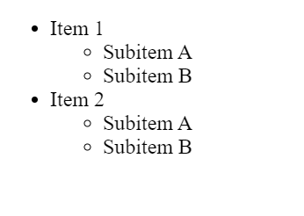

Slide 34
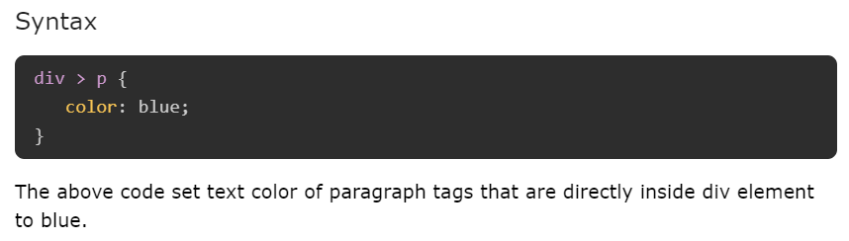
Combinator Selectors:: Child Selector
The child combinator (>) is placed between two CSS selectors.
The child selector in css is used to target all the direct child of a particular element.

Slide 35
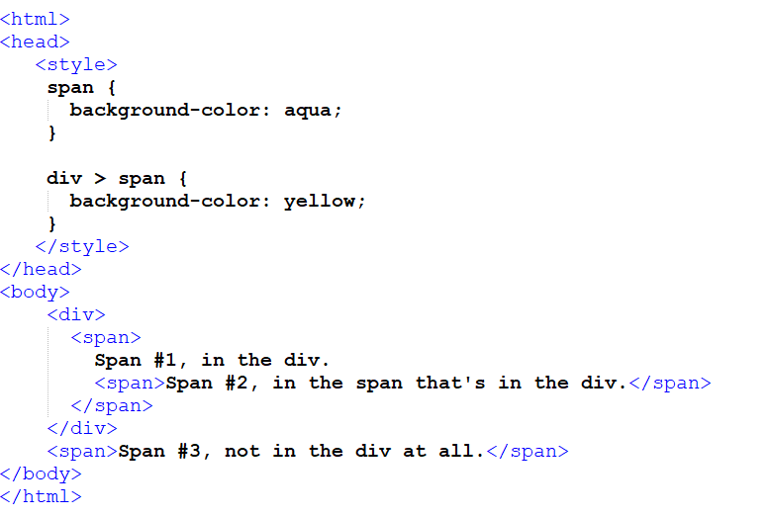
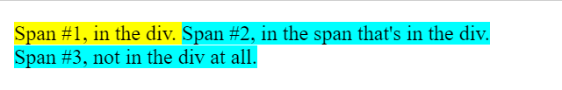

Slide 36
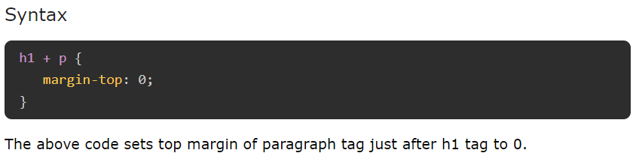

Combinator Selectors:: Adjacent Sibling Selector
In CSS, adjacent sibling selector is used to target an element that is immediately preceded by a specified element.
A plus symbol ( "+" ) is used to denote adjacent sibling.

Slide 37


Slide 38


Combinator Selectors:: General Sibling Selector
In CSS, general sibling selector is used to target all the element that is preceded by a specified element.
A tilde symbol ( "~" ) is used to denote general sibling.

Slide 39



Slide 40

Pseudo Class Selector
Pseudo-classes in CSS are used to select and style elements based on their state or position within the document tree, without the need for adding extra classes or JavaScript.
Pseudo-classes often used along with CSS Selectors by inserting a colon (:) after selector.
For example a : hover{}, Here selector `a` will selects all the anchor tags in document.

Slide 41

Pseudo-Class Hover
In CSS, pseudo-class :hover is used to specify mouse hovering state of an element.
This used to style element while users mouse passes through an element in document.

Slide 42



On hover

Slide 43
Pseudo-Class Active
The pseudo-class :active will apply style to an element when user activates the element by clicking or tapping on it.
This is most commonly used with interactive elements like button and anchor tag, but all the HTML elements can use this pseudo-class.

Slide 44



Slide 45
Pseudo-Class Focus
The pseudo-class :focus will apply style to an element when user focused an element like input tag by clicking on it.
Before typing text in input element users has to click in input area to enable cursor, this is called focusing.

Slide 46





Slide 47




CSS :visited Pseudo Class
This pseudo-class is used to select the links which have been already visited by the user.

Slide 48

Pseudo Element Selector
A pseudo-element selector is used to style a specific part of an element rather than the element itself.
For example, first letter of some paragraphs is larger than rest of letters.
Pseudo-elements are denoted by a double colon (::) notation.

Slide 49
1. CSS ::first-line Pseudo Element
Applies styles to the first line of a block-level element. Note that the length of the first line depends on many factors, including the width of the element, the width of the document, and the font size of the text. Note that only a few properties are applied for first-line pseudo-element like font properties, color properties, background properties, word-spacing, letter-spacing, text-decoration, vertical-align, text-transform, line-height, clear, etc.
2. CSS ::first-letter Pseudo Element
Applies styles to the first letter of the first line of a block-level element, but only when not preceded by other content (such as images or inline tables). Note that only a few properties are applied for first-letter pseudo-element like font properties, color properties, background properties, word-spacing, letter-spacing, text-decoration, vertical-align, text-transform, line-height, clear, etc.
3. CSS ::before Pseudo Element
Creates a pseudo-element that is the first child of the selected element. It is often used to add cosmetic content to an element with the content property. It is inline by default.

Slide 50
4. CSS ::after Pseudo Element
Creates a pseudo-element that is the last child of the selected element. It is often used to add cosmetic content to an element with the content property. It is inline by default.
5. CSS ::marker Pseudo Element
Selects the marker box of a list item, which typically contains a bullet or number. It works on any element or pseudo-element set to display: list-item, such as the <li> and <summary> elements.
6. CSS ::selection Pseudo Element
Applies styles to the part of a document that has been highlighted by the user such as clicking and dragging the mouse across the text.

Slide 51



Slide 52




Slide 53




Slide 54





Slide 55

CSS Attribute Selector
The CSS Attribute Selector allows you to target elements based on their specific attributes or attribute values.
This selector enhances the precision and efficiency of your CSS, enabling you to apply styles to elements that share common attributes.
By leveraging attribute selectors, you can maintain a more organized and scalable CSS codebase.
Syntax:

Slide 56
[attr] Represents elements with an attribute name of attr.
[attr=value] Represents elements with an attribute name of attr whose value is exactly value.
[attr~=value] Represents elements with an attribute name of attr whose value is a whitespace-separated list of words, one of which is exactly value.
[attr^=value] Represents elements with an attribute name of attr whose value is prefixed (preceded) by value.
[attr$=value] Represents elements with an attribute name of attr whose value is suffixed (followed) by value.
[attr*=value] Represents elements with an attribute name of attr whose value contains at least one occurrence of value within the string.
[attr operator value i] Adding an i (or I) before the closing bracket causes the value to be compared case-insensitively.
[attr operator value s] Adding an s (or S) before the closing bracket causes the value to be compared case-sensitively.

Slide 57



Types of CSS Attribute Selectors
1. CSS [attribute] Selector
The [attribute] Selector is used to select all the elements that have the specified attribute and applies the CSS property to that attribute. For example, the selector [class] will select all the elements with the class attribute.

Slide 58


CSS element [attribute] Selector can be used to restrict some particular elements, then it needs to specify that element before the attribute selector.

Slide 59


2. CSS [attribute = “value”] Selector is used to select all the elements whose attribute has the value exactly the same as the specified value.

Slide 60



3. CSS [attribute~=”value”] Selector is used to select all the elements whose attribute value is a list of space-separated values, one of which is exactly equal to the specified value.

Slide 61



4. CSS [attribute|=”value”] Selector is used to select all the elements whose attribute has a hyphen-separated list of values beginning with the specified value. The value has to be a whole word either alone or followed by a hyphen.

Slide 62



5. CSS [attribute^=”value”] Selector is used to select all the elements whose attribute value begins with the specified value. The value doesn’t need to be a whole word.

Slide 63



6. CSS [attribute$=”value”] Selector is used to select all the elements whose attribute value ends with the specified value. The value doesn’t need to be a whole word.

Slide 64



7. CSS [attribute*=”value”] Selector selects all the elements whose attribute value contains the specified value present anywhere. The value doesn’t need to be a whole word.

Slide 65
How CSS Rules Cascade
The term "cascading" in CSS refers to the process by which the browser decides which CSS rules to apply when multiple rules could apply to the same element.
Last rule : If the two selectors are identical, the latter of the two will take precedence.
Rule Specificity: If one selector is more specific than the others, the more specific rule will take precedence over more general ones
For Ex.
Inline styles (e.g., style="color: red;") have the highest specificity.
ID selectors (e.g., #header) are more specific than class selectors (e.g., .nav).
Class selectors are more specific than element selectors (e.g., p).

Slide 66

Colors
CSS Colors can be specified using predefined name of colors, RGB,
RGBA, HSL, HSLA and Hexadecimal values.
CSS allow us to change background color, text color, border color of any elements.
rgb values : These express colors in terms of how much red, green and blue
are used to make it up. For example: rgb(100,100,90) hex Codes : These are six-digit codes that represent the amount of red, green and blue in a color, preceded by a pound or hash # sign. For example: #ee3e80 Color names :There are 147 predefined color names that are recognized by browsers. For example DarkCyan
RGBA : The CSS3 rgba property allows you to specify a color, just like you would with an RGB value, but adds a fourth value to indicate opacity. This value is known as an alpha value and is a number between 0.0 and 1.0

Slide 67

CSS3: HSL and HSLA
The hsl color property has been introduced in CSS3 as an alternative way to specify colors
Alpha This is expressed as a number between 0 and 1.0. For example, 0.5 represents 50% transparency, and 0.0: fully transparent.

Slide 68

Box Model
The key to understanding how CSS works is to imagine that there is an invisible box around every HTML element.
The CSS box model is essentially a box that wraps around every HTML element. It consists of: content, padding, borders and margins
CSS allows you to create rules that control the way that each individual box (and the contents of that box) is presented.

Slide 69
Content - The content of the box, where text and images appear
Padding - Clears an area around the content. The padding is transparent
Border - A border that goes around the padding and content
Margin - Clears an area outside the border. The margin is transparent

Slide 70

CSS Height & Width

Slide 71
CSS height and width Values
The height and width properties may have the following values:
auto - This is default. The browser calculates the height and width
length - Defines the height/width in px, cm, etc.
% - Defines the height/width in percent of the containing block
initial - Sets the height/width to its default value
inherit - The height/width will be inherited from its parent value

Slide 72
Width and Height of an Element
The total width of an element should be calculated like this:
Total element width = width + left padding + right padding + left border + right border
The total height of an element should be calculated like this:
Total element height = height + top padding + bottom padding + top border + bottom border

Slide 73



Slide 74
Limiting height and width
Property | Description
max-height | Sets the maximum height of an element
max-width | Sets the maximum width of an element
min-height | Sets the minimum height of an element
min-width | Sets the minimum width of an element

Slide 75
Overflow
The overflow property tells the browser what to do if the content contained within a box is larger than the box itself.
The overflow property has the following values:
visible - Default. The overflow is not clipped. The content renders outside the element's box
hidden - The overflow is clipped, and the rest of the content will be invisible
scroll - The overflow is clipped, and a scrollbar is added to see the rest of the content
auto - Similar to scroll, but it adds scrollbars only when necessary

Slide 76


With default overflow value :: visible

Slide 77


With overflow value :: scroll

Slide 78


With overflow value :: hidden

Slide 79
CSS Border
The border property is used to create a border around an element, such as a div, image, or text. It allows you to customize the appearance of the border, including its color, width, and style.
Types of Border Properties
border-style: Specifies whether a border should be solid, dashed line, double line, or one of the other possible values
border-width: Specifies the width of a border
border-color: Specifies the color of a border

Slide 80



border-style
The border-style property is used to specify type of border style for an element.

Slide 81


Border Style For Individual Sides
The property border-style can be exclusively specified for each single-side

Slide 82


Border Width Property
The border-width used to specify thickness of a border around an element. It can have values like thin, medium, thick or any length (in px, or em ).

Slide 83


Border Color Property
The border-color is used to set the color of border.

Slide 84

Border Shorthand Property
In CSS, we can use border property to specify style, width and color of border.

Slide 85


CSS Image As Border
CSS also allows to set images as borders for other element like div, span, body, paragraph etc using border-image property.
Declare the border-style before providing an image source, else no image will be displayed as the border.

Slide 86


Border Radius Property
CSS border-radius property is used to specify roundness of border edges. The value for this property can be in length (px, em) or percentages.
A border radius 50% indicate a complete circle.

Slide 87
CSS Margin
The margin property controls the gap between boxes. Its value is commonly given in pixels, although you may also use percentages or ems.
margin for individual sides using properties margin-bottom, margin-top, margin-left and margin-right
Negative Margin: A margin with negative value indicate the elements overlap with each other.
All the margin properties can have the following values:
auto - the browser calculates the margin
length - specifies a margin in px, pt, cm, etc.
% - specifies a margin in % of the width of the containing element
inherit - specifies that the margin should be inherited from the parent element

Slide 88



Slide 89
Different Ways to Apply Margin on HTML Elements
There are four ways to provide value to the CSS margin
Single Values: Here you can provide a single value to the margin property that same value will be applicable on four sides of the the element.
Two Values: Here you have to provide two values that will be used as top, bottom and right, left margin value.
Three Values: In this way you can provide three values that will define top, left, right and bottom value. Like if you set margin: 20px 40px 10px. In this case top margin will be 20px, right and left margins will be 40px and bottom margin will be 10px.
Four Values: If you provide four values to the margin property it will generate top margin from first value, right margin from 2nd value and so on.

Slide 90





Slide 91

Margin Mix up Units
CSS does not restrict usage of multiple units for specifying the values of margin, while specifying in shorthand property.
That means one can pass values of length as pixel along with ems or inches, etc.

Slide 92


Auto value
You can set the margin property to auto to horizontally center the element within its container.
The element will then take up the specified width, and the remaining space will be split equally between the left and right margins.

Slide 93
CSS Padding
CSS padding is used to creates extra space between border of element and it's contents.
CSS has properties for specifying the padding for each side of an element:
padding-top
padding-right
padding-bottom
padding-left
All the padding properties can have the following values:
length - specifies a padding in px, pt, cm, etc.
% - specifies a padding in % of the width of the containing element
inherit - specifies that the padding should be inherited from the parent element
Note: Negative values are not allowed.

Slide 94


Slide 95



Slide 96




Slide 97



CSS Buttons
Buttons are interactive elements that allow users to perform actions on your website or application.

Slide 98
Styling Properties for Buttons
1. Background and Text Color | button { background-color: #4CAF50; color: white; }
2. Padding and Margins | button { padding: 10px 20px; margin: 5px; }
3. Borders and Border Radius | button { border: 2px solid #4CAF50; border-radius: 5px; }
4. Hover Effects | button:hover { background-color: #45a049; }
5. Font and Text Styling | button { font-size: 16px; font-weight: bold; }
6. Box Shadow | button { box-shadow: 2px 2px 5px rgba(0, 0, 0, 0.2); }

Slide 99





On hover
Disabled Buttons:

Slide 100

CSS float and clear
The float property is used for positioning and formatting content e.g. let an image float left to the text in a container.
left - The element floats to the left of its container
right - The element floats to the right of its container
none - The element does not float (will be displayed just where it occurs in the text). (Default)
inherit - The element inherits the float value of its parent

Slide 101



Slide 102


Slide 103

Clear Property
The way elements interact with floated elements is controlled by the clear property.
It shows if an element can be placed next to elements that have already floated.
none: No effect on adjacent elements, allowing them to position themselves freely.
left: Forces the element below any left-floating elements.
right: Forces the element below any right-floating elements.
both: Forces the element below both left and right floating elements.
inherit: Inherits the clear property from its parent element.

Slide 104




Slide 105


Clearfix: If a floated element is taller than the containing element, it will "overflow" outside of its container. We can then add a clearfix to solve this problem.
The overflow: auto clearfix works well as long as you are able to keep control of your margins and padding (else you might see scrollbars).

Slide 106



Slide 107

CSS align – horizontal and center

Slide 108
CSS Positioning
CSS property position helps manipulate position of an element in a web page. Ex: top of the webpage/bottom of the webpage/ left or right.
The position property specifies the type of positioning method used for an element.
There are five different position values:
Static(default)
relative
fixed
absolute
sticky

Slide 109
Value | Description | Example
static | Default positioning. Elements are positioned according to the normal document flow (no special positioning). | position: static; (default)
relative | Positioned relative to its normal position. You can use top, right, bottom, and left properties to offset it. | position: relative;
absolute | Positioned relative to its nearest positioned ancestor (excluding static ancestors) or the initial containing block if none exist. The element is completely removed from the document flow. An absolutely positioned element may overlap other elements, or be overlapped by them. | position: absolute;
fixed | Positioned relative to the browser window. The element stays in place even when the page is scrolled. Here the element is totally removed from the document's flow. | position: fixed;
sticky | Positioned based on the user's scroll position. Toggles between relative and fixed depending on the scroll. | position: sticky;

Slide 110

CSS Background

Slide 111



CSS Outline
The outline-offset property adds space between an outline and the edge/border of an element. The space between an element and its outline is transparent.

Slide 112



Slide 113
CSS Link
Links are used to navigate from one webpage to other with a single click.
CSS properties can be used to style links in various ways.
States of Link : A link in a webpage exist in various states, and these states of link can be styled using pseudo-classes in CSS.
Link: Represents unvisited links. This is default state for anchor tag. [pseudo class is :link]
Visited: Represents the links that are already visited (present in browser's history). [pseudo class is :visited]
Hover: Represents the state when user hover's the mouse pointer over link. [pseudo class is :hover]
Active: Represents the state when user clicks the link. [pseudo class is :active]

Slide 114

Basic styling properties of Link
color
background-color
border
font family
text decoration

Slide 115

CSS List
The CSS list properties allow you to:
Set different list item markers for ordered lists
Set different list item markers for unordered lists
Set an image as the list item marker
Add background colors to lists and list items

Slide 116
CSS List Style
List Style Type | Description | Example
disc | Default bullet for unordered lists | ●
circle | Hollow circle bullet | ○
square | Solid square bullet | ■
decimal | Numbered list with decimal numbers | 1, 2, 3, 4, ...
decimal-leading-zero | Numbers with leading zeros | 01, 02, 03, 04, ...
lower-roman | Lowercase Roman numerals | i, ii, iii, iv, ...
upper-roman | Uppercase Roman numerals | I, II, III, IV, ...
lower-alpha | Lowercase alphabetic letters | a, b, c, d, ...
upper-alpha | Uppercase alphabetic letters | A, B, C, D, ...
none | No bullet or number | (No marker)
georgian | Traditional Georgian numbering | an, ban, gan, ...
armenian | Armenian numbering | Ա, Բ, Գ, Դ, ...

Slide 117




Slide 118

Item list marker - an image
The list-style-image property can be used to specify an image as an item list marker.

Slide 119
The list item marker - Position or Bullet position
The list-style-position property indicates whether the marker should appear inside or outside of the box containing the bullet points.
Sr.No. | Value | Description
1 | none | NA
2 | inside | If the text goes onto a second line, the text will wrap underneath the marker. It will also have proper indentation.
3 | outside | If the text goes onto a second line, the text will be aligned with the start of the first line (to the right of the bullet).
4 | inherit | Inherits the property of the parent list.

Slide 120





Slide 121
CSS Table
CSS allows you to style HTML tables to make them more visually appealing and easier to read
CSS Tables - Border Collapse : The property border-collapse ensures that borders between table cells collapse into a single border, creating a cleaner look. Property border-collapse can have values collapse or separate (default).
CSS Tables - Border Spacing : The border-spacing property specifies the distance that separates adjacent cells’
Note: The border-spacing property only works when border-collapse is set to separate. If you set border-collapse to collapse, the border-spacing property will have no effect.
3. CSS Tables - Caption Side : The caption-side property in CSS is used to control the placement or alignment of the table caption in relation to the table. Ex: top, bottom, block-start, block-end, inherit

Slide 122





Without border-collapse (separate collapse)
With border-collapse

Slide 123



Slide 124





Slide 125




